Slide 1


KELOMPOK 35
CHECKPOINT 3
DBA2150263 FAISHAL AMIN ABYAN
DBA2164865 ANNASTASYA GHOFRA NURFADHILLA
DBA2182410 AMARA AMELIA PUTRI
DBA2203148 DAVID WILLIAM TANTO, OEI
DBA-H
Final Project

Slide 2
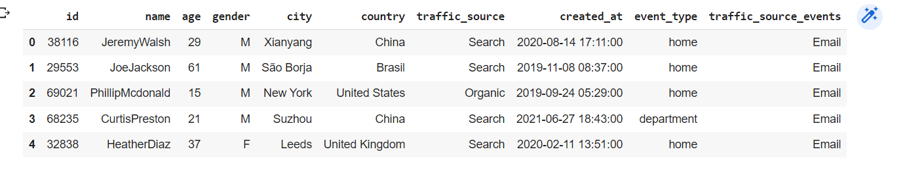
DEPARTEMENT MARKETING
Revisi Checkpoint 2
Inner Join → Left Join
4 Table → 2 Table ( Users, Events )
Kolom products.category → Kolom events.traffic_source

Slide 3
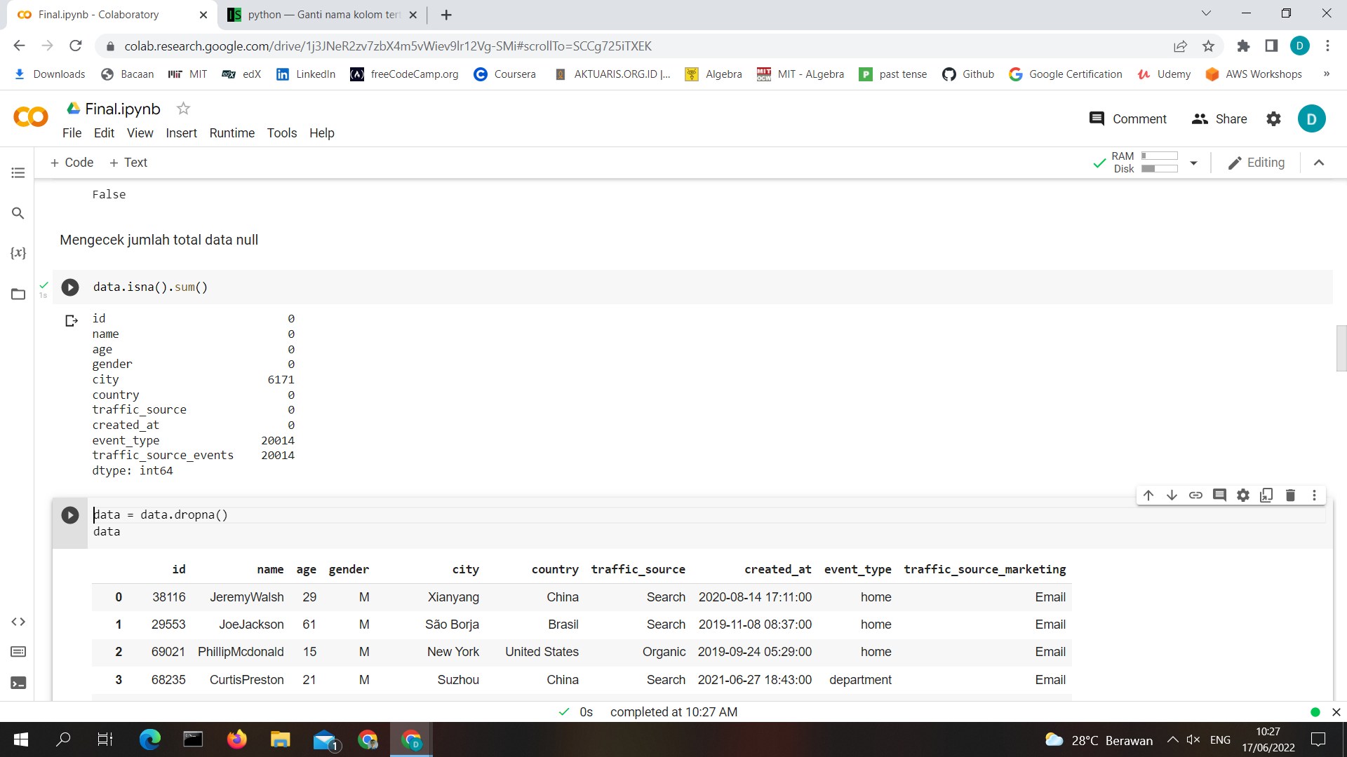
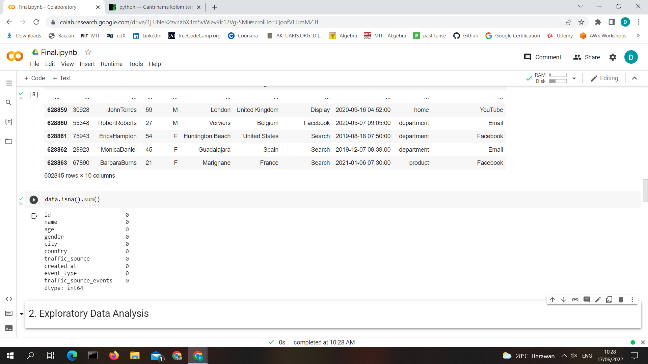
DEPARTEMENT MARKETING
Mengecek data null

Slide 4
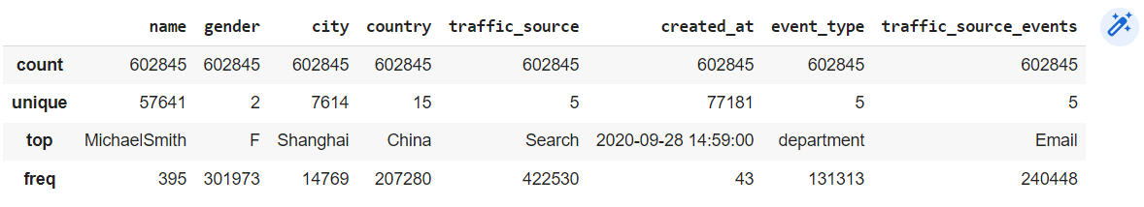
DEPARTEMENT MARKETING
Summary statistics of the Categorical features

Slide 5
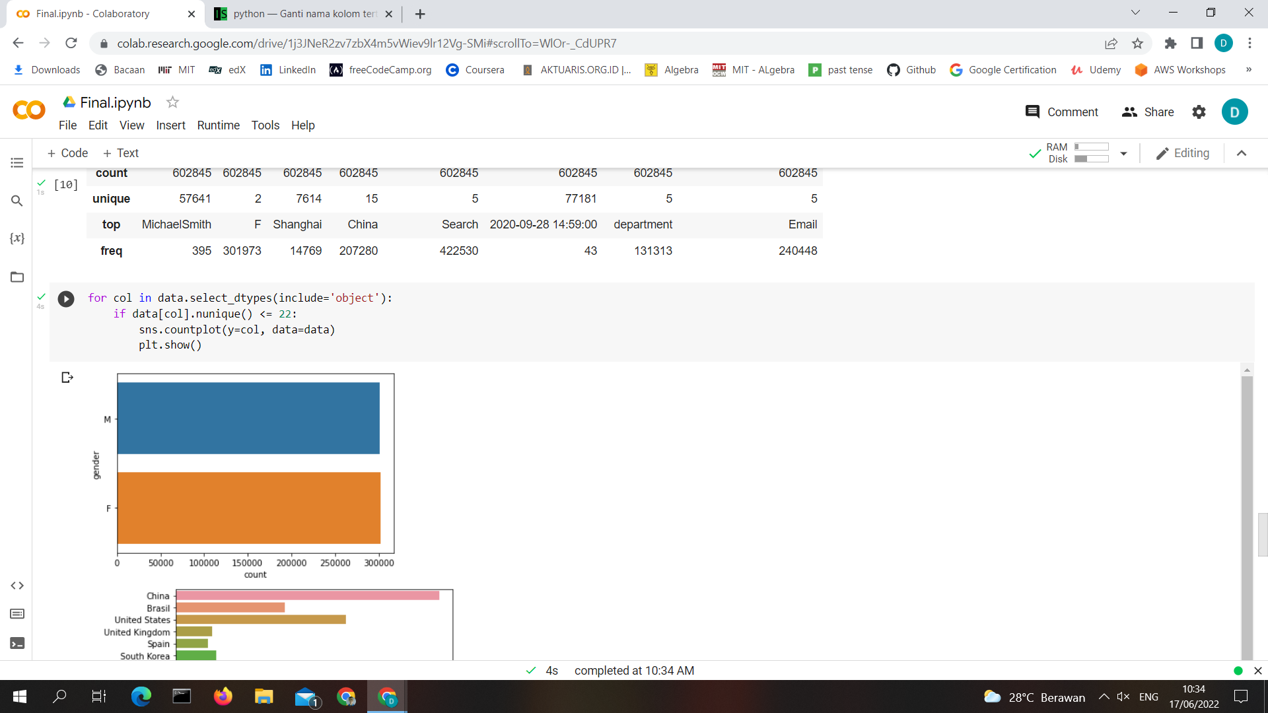
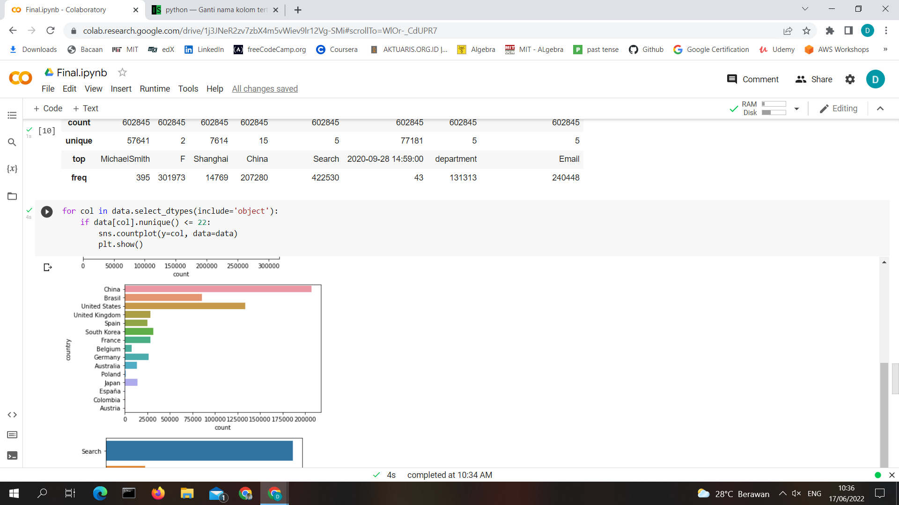
DEPARTEMENT MARKETING
Plot categorical distributions
Gender
Country

Slide 6
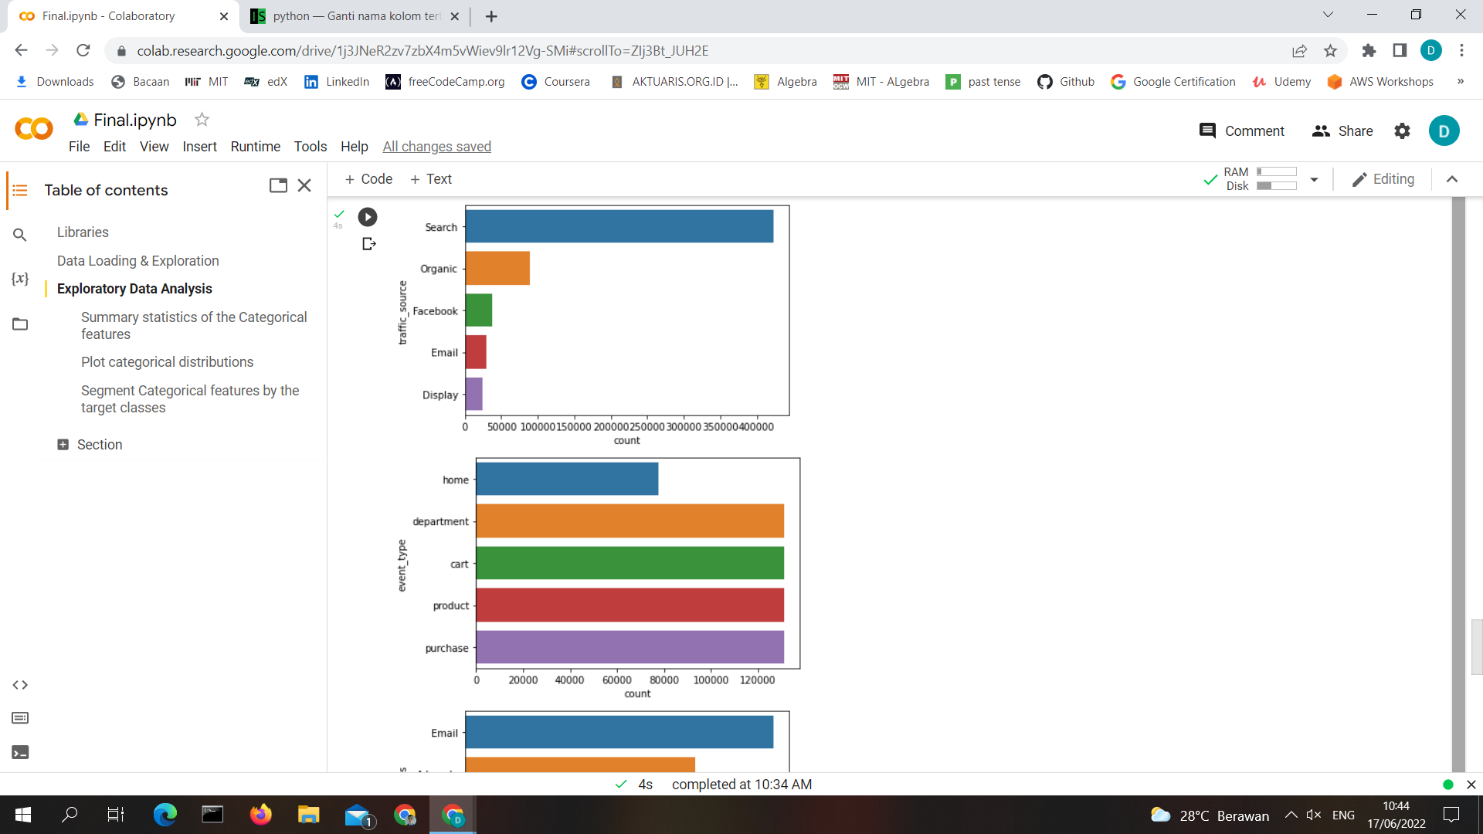
DEPARTEMENT MARKETING
Plot categorical distributions
traffic_source
event_type

Slide 7
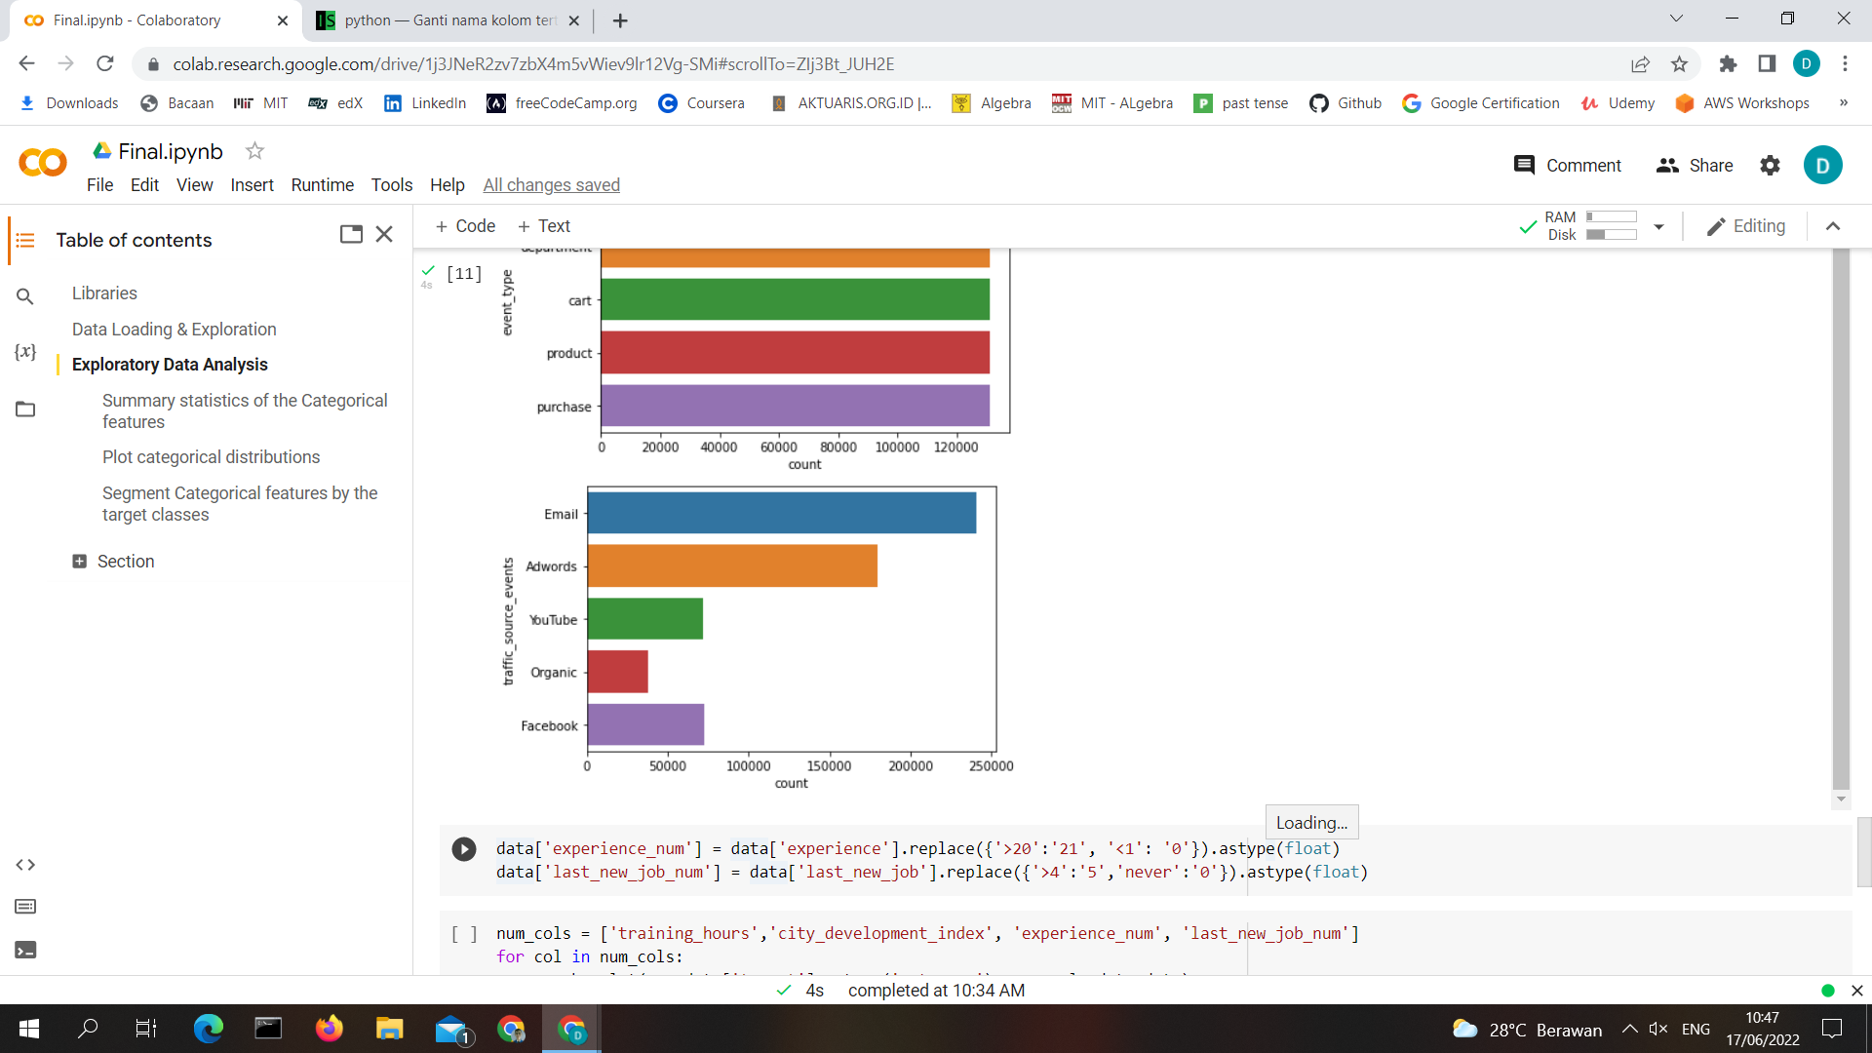
DEPARTEMENT MARKETING
Plot categorical distributions
traffic_source_events

Slide 8
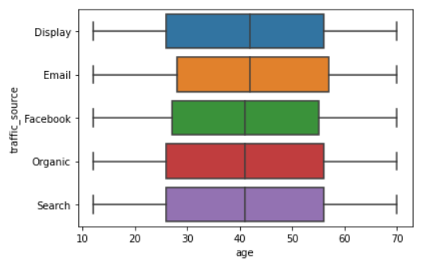
DEPARTEMENT MARKETING
Segment the target ( traffic_source ) by numeric features ( age )
Kesimpulan :
Display → Umur 25 - 53
Email → Umur 27 - 55
Facebook → Umur 26 - 53
Organic → Umur 25 - 55
Search → Umur 25 - 55

Slide 9
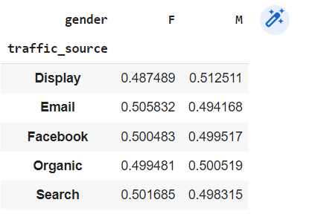
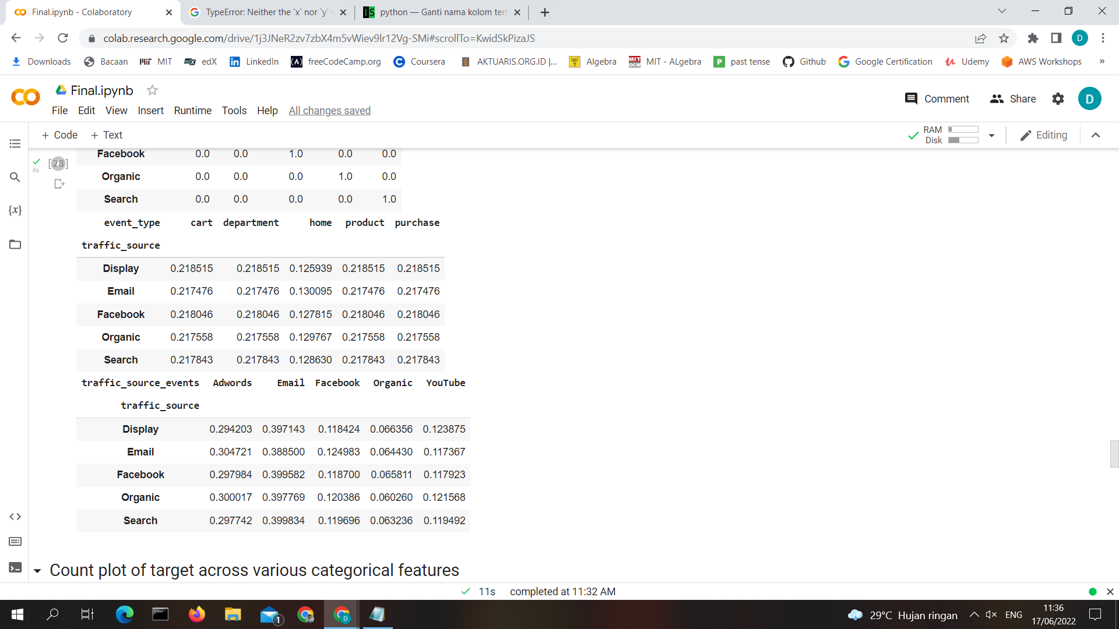
DEPARTEMENT MARKETING
Segment Categorical features by the target classes
Gender with traffic_source
event_type with traffic_source

Slide 10
DEPARTEMENT MARKETING
traffic_source_events with traffic_source

Slide 11
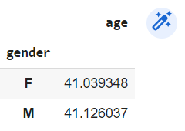
DEPARTEMENT MARKETING
Group numeric features by categorical features
Gender with age

Slide 12
THANKS

